Slide 1
TESTABILITY MEASURES
Dr. Gaganpreet Kaur

Slide 2
What is testabilty
A fault is testable if there exists a well specified procedure and implement it at reasonable cost.
Use of fault list
Assumes every fault in the list is testable

Slide 3
Need and Uses
Need approximate measure of:
Difficulty of setting internal circuit lines to 0 or 1 by setting primary circuit inputs
Difficulty of observing internal circuit lines by observing primary outputs
Uses:
Analysis of difficulty of testing internal circuit parts – redesign or add special test hardware
Guidance for algorithms computing test patterns – avoid using hard-to-control lines
Estimation of fault coverage
Estimation of test vector length

Slide 4
Testability Measures
Measure of difficulty of making a circuit testable based on controllability and observability.
So, Testability analysis, Involves circuit topological analysis, but no test vectors and no search algorithm- it’s a Static analysis
Possesses a Linear computational complexity
Originally Rutman 1972 -- First definition of controllability
Goldstein 1979 – SCOAP, First definition of observability
No of testability meausures- TMEAS, SCOAP, TESTSCREEN, CAMELOT, VICTOR, COMET

Slide 5
SCOAP
“Sandia Controllability and Observability Analysis Program”
Combinational measures
􀂆 CC0 – difficulty of setting circuit line to logic 0
􀂆 CC1 – difficulty of setting circuit line to logic 1
􀂆 CO – difficulty of observing a circuit line Sequential measures
􀂆 SC0 – difficulty of setting circuit line to logic 0
􀂆 SC1 – difficulty of setting circuit line to logic 1
􀂆 SO – difficulty of observing a circuit line

Slide 6
SCOAP Measures
Range of metrics
Controllability – 1 (easiest) to infinity (hardest)
Observability – 0 (easiest) to infinity (hardest)
Initially, all testability measures are set to infinity
Controllability calculation
- Proceed from the inputs to the outputs
-Controllability measures of primary inputs (including branches) are all equal to 1
Observability calcaulation
- Start from the most observable nodes, the primary outputs, and proceed backward to the primary inputs

Slide 7
SCOAP PROCEDURE
First, all the primary inputs are directly assigned CC0=1 and CC1 =1
CC0 and CC1 are determined level wise for the circuit using SCOAP rules for logic gates.
For combinational observability (CO) of all primary outputs is assumed 0
CO values are determined level wise for the circuit (now moving from primary outputs to primary inputs) using SCOAP rules.

Slide 8
SCOAP RULES: Combinational Logic
General rules for setting controllabilities
If only one input sets gate output;
output controllability = min (input controllabilites) + 1
If all inputs set gate output;
output controllability = sum (input controllabilities) + 1
If gate output is determined by multiple input sets, e.g., XOR;
output controllability = min(controllabilities of input sets) + 1

Slide 9
Controllability for gates
A
Y
B

Slide 10
NAND
A
Y
B

Slide 11
OR
A
Y
B

Slide 12
NOR
A
Y
B

Slide 13
NOT

Slide 14
XOR
A
Y
B

Slide 15
XNOR
A
Y
B

Slide 16
A small Circuit
A
D
B
A
Y
C

Slide 19
Sequential Controllability
Increment the sequential measure by 1 only when:
Signals propagate from FF inputs to Q or Q, or
Signals propagate from FF outputs backwards to D, Clk, SET or RESET inputs.
One must iterate on feedback loops until controllabilities stabilize.
SC0, SC1 and SO formulas differ from CC0, CC1 and C0 only in that you do NOT add one when moving from one level to another.
SC0 and SC1 roughly measure the number of times various FFs must be clocked to control a signal.

Slide 20
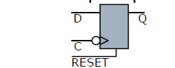
Sequential Controllability
􀂄 CC1(Q)=CC1(D)+CC1(C)+CC0(C)+CC0(RESET)
􀂄 SC1(Q)=SC1(D)+SC1(C)+SC0(C)+SC0(RESET) +1
􀂄 CC1 measures how many lines in the circuit must be set to make Q as 1
􀂄 SC1 measures how many flip-flops in the circuit must be clocked to set Q to 1

Slide 21
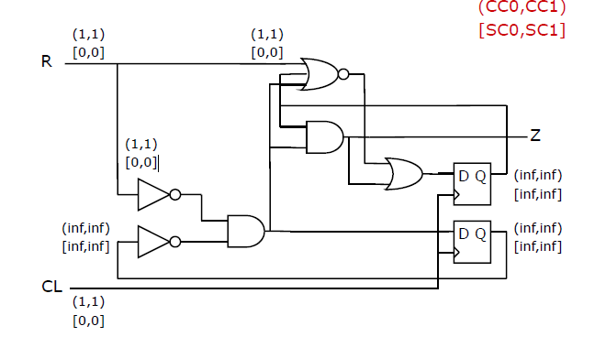

Slide 22
2nd iteration

Slide 23
3rd Iteration

Slide 24
4t iteration

Slide 25
OBSERVABILITY
Measure of difficulty to observe a point
‘0’ for Primary Outputs and max is Infinity
To analyse circuit for observability start from Output towards inputs.
Initially all points have Observability at infinity except for primary outputs.
For gates: Observability at controlling input is computed by sum of Observatility at Output and Combinational controllabilty(0 or1) at non controlling input + 1(for increase in level)

Slide 26
Observability rule for Fanout
To observe a fanout stem Observe it through branch with minimum observability
CO(a)=min (CO(z1), CO(z2), …, CO(zn))

Slide 27
Controllability for gates
A
Y
B

Slide 28
NAND
A
Y
B

Slide 29
OR
A
Y
B

Slide 30
NOR
A
Y
B

Slide 31
NOT

Slide 32
XOR
A
Y
B

Slide 33
XNOR
A
Y
B

Slide 34
A small Circuit
A
D
B
A
Y
C

Slide 36
Sequential Observability
Consider a D-Flip flop
Observability of D
CO(D)=CO(Q)+CC1(C)+CC0(C)+CC0(RESET)
SO(D)=SO(Q)+SC1(C)+SC0(C)+SC0(RESET)+1
Observability of RESET
CO(RESET)=CO(Q)+CC1(Q)+CC0(C)+CC1(RESET)
SO(RESET)= CO(Q)+CC1(Q)+CC0(C) + CC1(RESET)+1

Slide 37
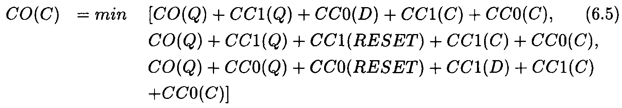
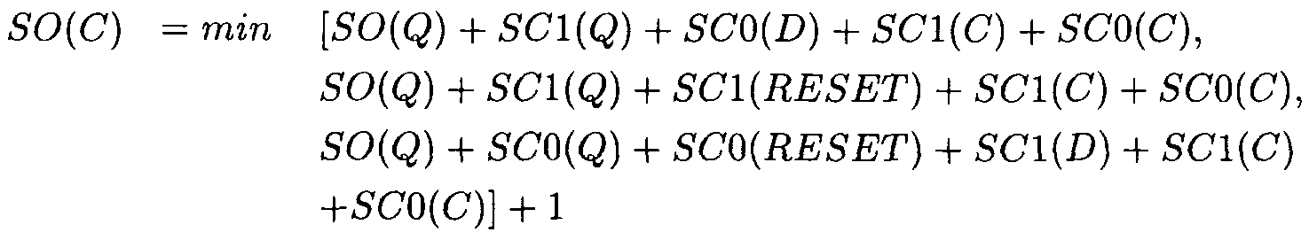
Sequential Observability
Conditions:(1) set Q to 1 and clocking a 0 from D,
(2) set Q to 1 and synchronously apply RESET,
(3) set Q to 0 and clock in a 1 from D while holding RESET to 0.

Slide 38
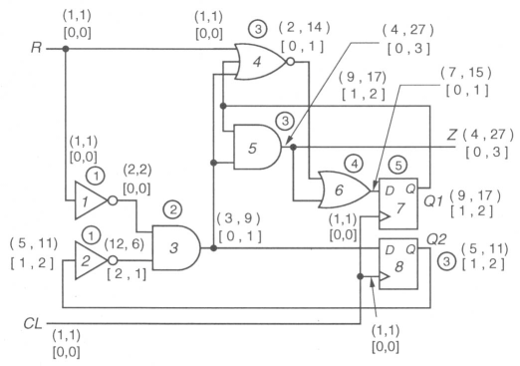
Compute for following circuit

Slide 39
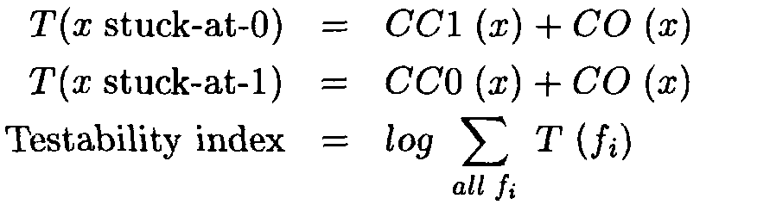
Use of SCOAP:

Slide 40
Limitation of SCOAP
For Reconvergent Fan-out it fails

Slide 41
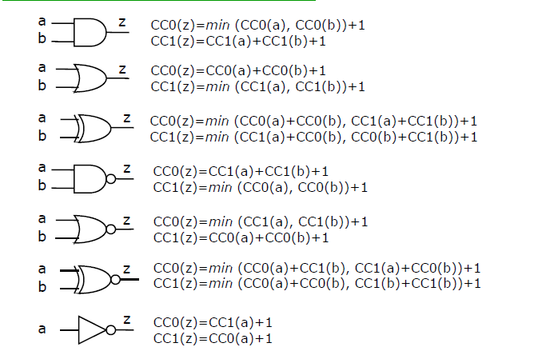
Summarizing Controllability

Slide 42
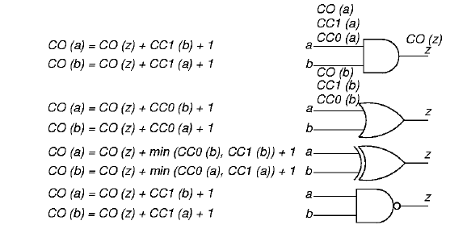
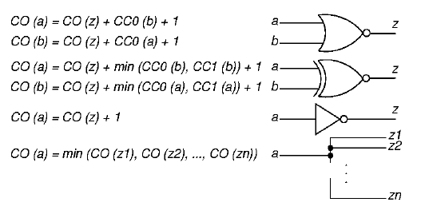
Summarizing Observability

